Slide 1
AQA
A Level
Computer Science
Paper 1
Graph traversal algorithms
Unit 8
Algorithms

Slide 2
Objectives
Be able to trace depth-first and breadth-first algorithms
Describe typical applications of each

Slide 3
A list representation of a graph
Draw the graph represented by the following list:
A |  | [B, C]
B |  | [A, D, E]
C |  | [A, F, G]
D |  | [B, E]
E |  | [B, D]
F |  | [C,G]
G |  | [C,F,H,I]
H |  | [G,I]
I |  | [G,H,X]
X |  | [I]

Slide 4
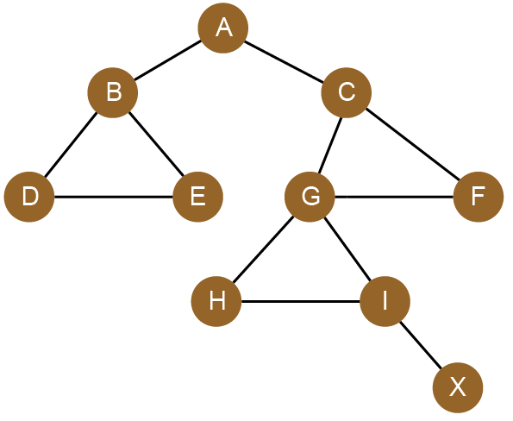
Answers
Terminology associated with graphs
B and C are adjacent nodes or neighbours of A
A |  | [B, C]
B |  | [A, D, E]
C |  | [A, F, G]
D |  | [B, E]
E |  | [B, D]
F |  | [C,G]
G |  | [C,F,H,I]
H |  | [G,I]
I |  | [G,H,X]
X |  | [I]
Node or vertex
Undirected edge

Slide 5
Traversing a graph
There are two ways of traversing a graph:
Depth-first
Breadth-first
With depth-first, you go as far as you can down a path before backtracking and going down the next path
With breadth-first, you explore all the neighbours of the current vertex, then the neighbours of each of those vertices and so on

Slide 6
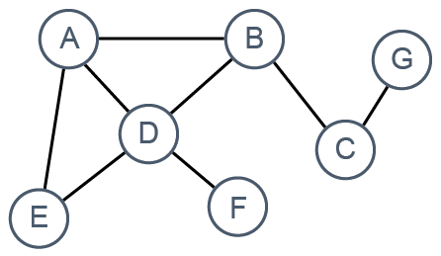
A depth-first traversal
We will traverse the graph represented by the following dictionary data structure
GRAPH = { "A":["B","D","E"], "B":["A","C","D"], "C":["B","G"], "D":["A","B","E","F"], "E":["A","D"] , "F":["D"], "G":["C"]}

Slide 7
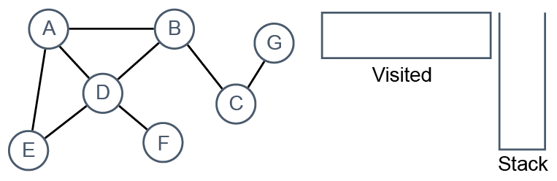
Depth-first traversal
The algorithm uses a stack to keep track of the last node visited, and a list to hold the names of nodes that have been visited
Start with an empty stack and an empty list

Slide 8
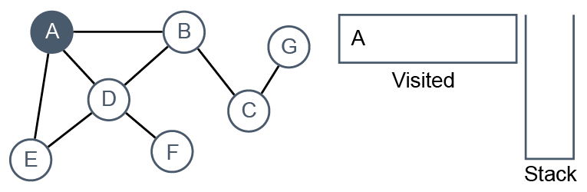
Depth-first traversal
Visit A, and add it to the visited list
Colour it blue to show it has been visited

Slide 9
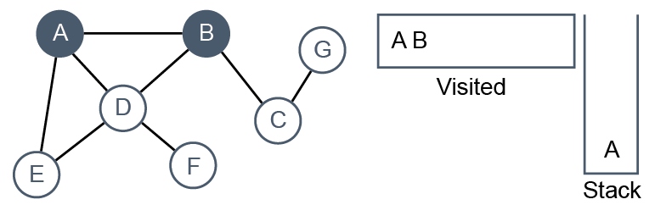
Depth-first traversal
Push A onto the stack to keep track of where we have come from and visit A’s first neighbour, B. Add it to the visited list
Colour it to show it has been visited

Slide 10
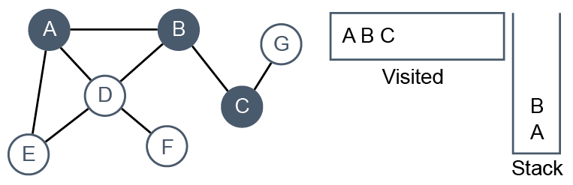
Depth-first traversal
Push B onto the stack and from B, visit the next unvisited node, C
Add it to the visited list
Colour it to show it has been visited

Slide 11
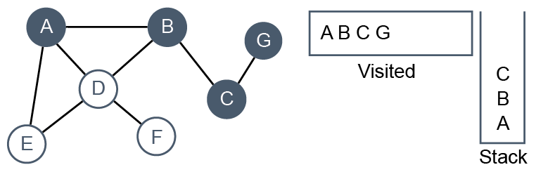
Depth-first traversal
Push C onto the stack and from C, visit the next unvisited node, G
Add it to the visited list. Colour G to show it has been visited

Slide 12
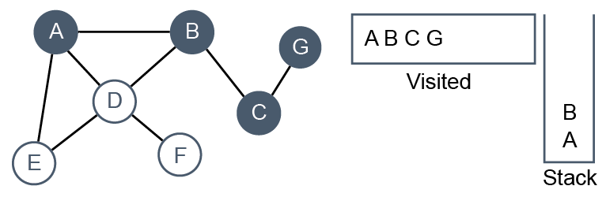
Depth-first traversal
At G, there are no unvisited nodes so we backtrack
Pop the previous node C off the stack and return to C
C

Slide 13
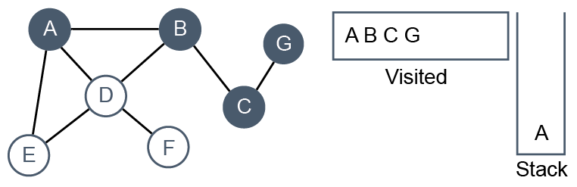
Depth-first traversal
At C, all adjacent nodes have been visited, so backtrack again
Pop B off the stack and return to B
B

Slide 14
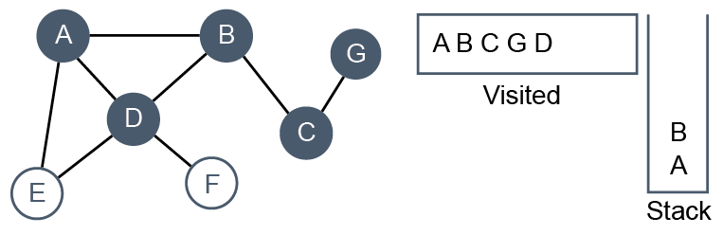
Depth-first traversal
Push B back onto the stack to keep track of where we have come from and visit D
Add it to the visited list
Colour D to show it has been visited

Slide 15
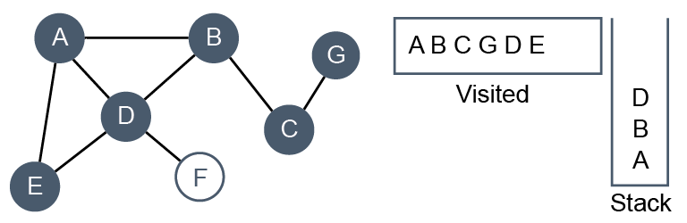
Depth-first traversal
Push D back onto the stack and visit E
Add E to the visited list
Colour E to show it has been visited

Slide 16
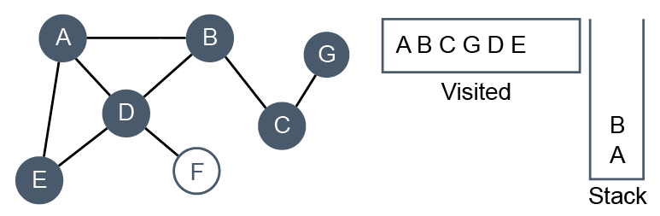
Depth-first traversal
From E, A and D have already been visited so pop D off the stack and return to D
D

Slide 17
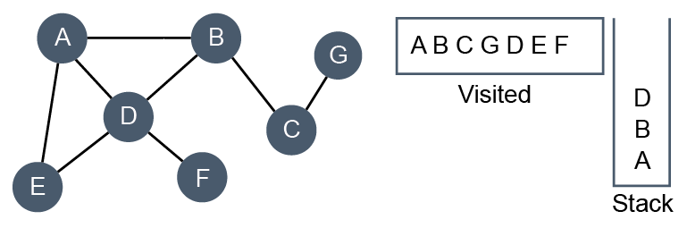
Depth-first traversal
Push D back onto the stack and visit F
Add it to the visited list
Colour it to show it has been visited

Slide 18
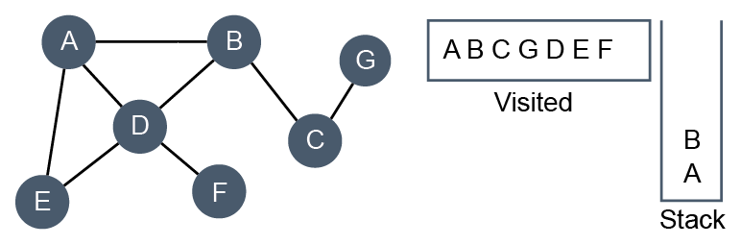
Depth-first traversal
At F, there are no unvisited nodes so we pop D
D

Slide 19
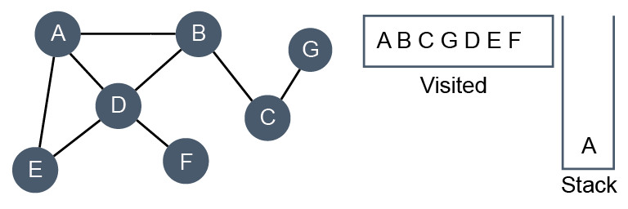
Depth-first traversal
B is popped
B

Slide 20
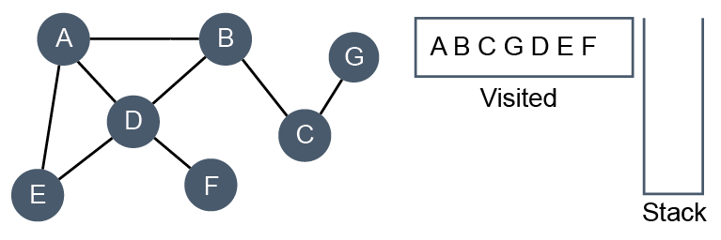
Depth-first traversal
A is popped
The stack is now empty which means every node has been visited and the algorithm has completed
A

Slide 21
Algorithm for depth-first
SUB dfs(graph, currentVertex, visited)
append currentVertex to list of visited nodes
FOR vertex in graph[currentVertex]
IF vertex NOT IN visited THEN
dfs(graph, vertex, visited)
ENDIF
ENDFOR
RETURN visited
ENDSUB
This subroutine returns a list of the nodes in the order that they have been visited

Slide 22
Applications of depth-first traversal
Job-scheduling, where some jobs have to be completed before others can begin
Finding a path between two vertices
Solving puzzles such as navigating a maze

Slide 23
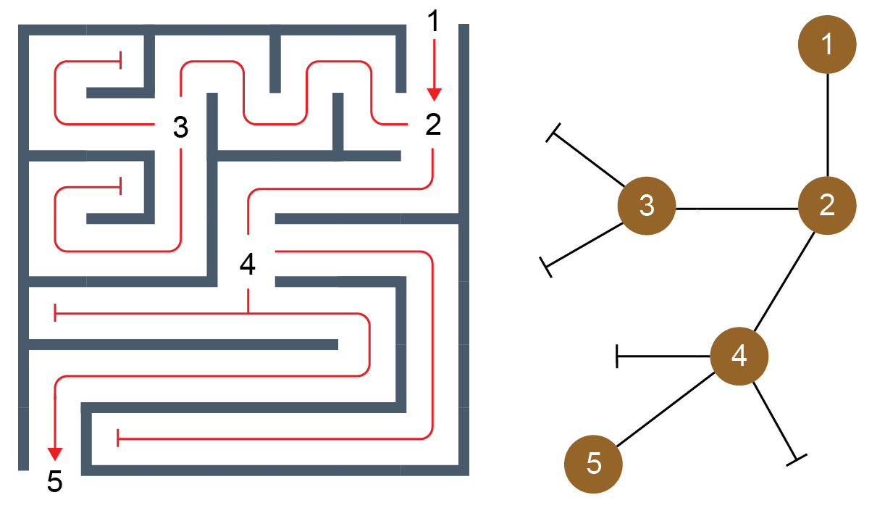
Graph representing a maze
A maze can be represented by a graph; dead ends are shown as a bar
Nodes represent the entrance to or exit from the maze, points at which more than one path can be taken, and dead ends

Slide 24
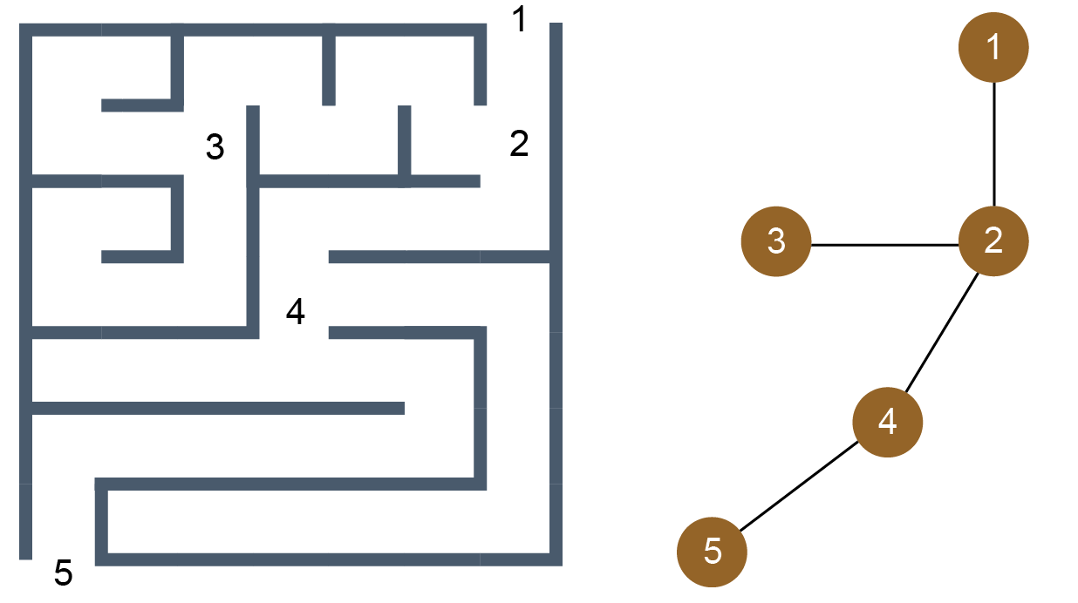
Graph representing a maze
Alternatively, you can draw the graph without showing dead ends:

Slide 25
Worksheet 4
Try Task 1 on the worksheet

Slide 26
Breadth-first traversal
With a breadth first traversal, all the nodes adjacent to A are visited before moving to B
The process is repeated for each node at this ‘level’, before moving to the next level
Instead of a stack, a queue is used to keep track of nodes that we still have to visit
Nodes are coloured pale blue when queued and dark blue when dequeued and added to the list of nodes that have been visited

Slide 27
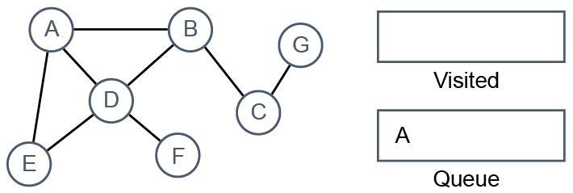
Breadth-first traversal
Append A to the empty queue at the start of the routine
This will be the first visited node

Slide 28
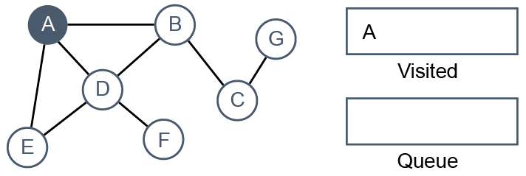
Breadth-first traversal
Dequeue A and mark it by colouring it dark blue
Add A to the visited list

Slide 29
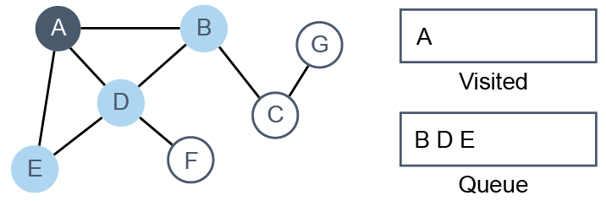
Breadth-first traversal
Queue each of A’s adjacent nodes B, D and E in turn
Colour each node pale blue to show it has been queued

Slide 30
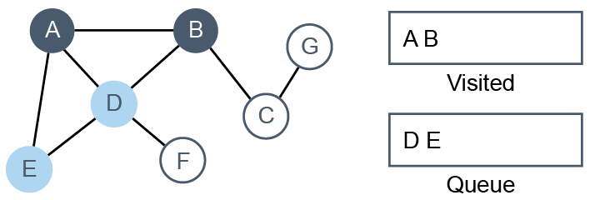
Breadth-first traversal
We’ve now finished with A, so dequeue the first item in the queue, which is B
Mark it by colouring it dark blue and add it to the visited list

Slide 31
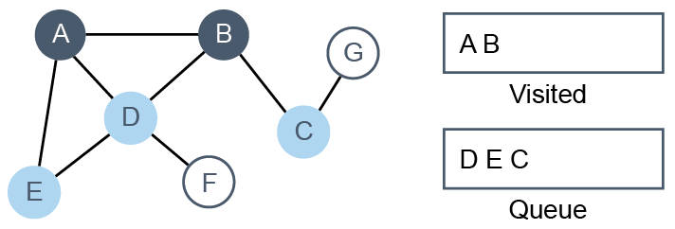
Breadth-first traversal
Queue B’s remaining neighbour C
Colour it pale blue to show it has been queued

Slide 32
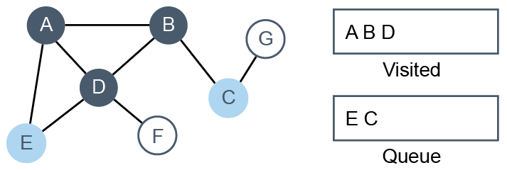
Breadth-first traversal
B’s neighbours are all coloured, so dequeue the first item in the queue, which is D
Mark it by colouring it dark blue and add it to the visited list

Slide 33
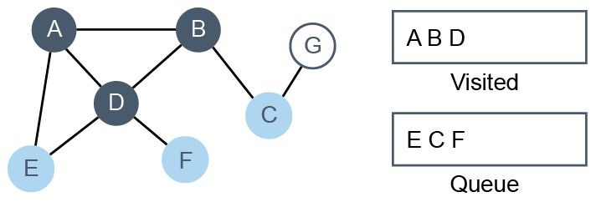
Breadth-first traversal
D’s adjacent node E has already been queued and coloured. Add D’s adjacent node F to the queue
Colour F pale blue to show it has been queued

Slide 34
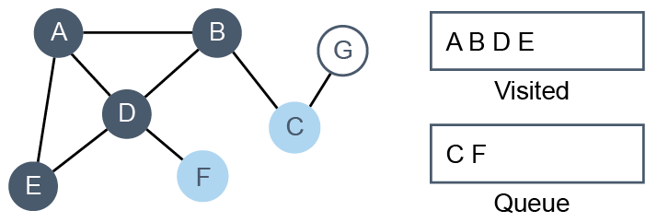
Breadth-first traversal
Dequeue the first item, E
Mark E by colouring it dark blue and add it to the visited list

Slide 35
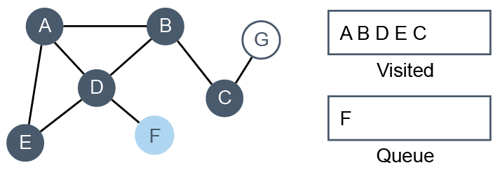
Breadth-first traversal
E’s neighbours are all coloured, so dequeue the next item, C
Mark C by colouring it dark blue and add it to the visited list

Slide 36
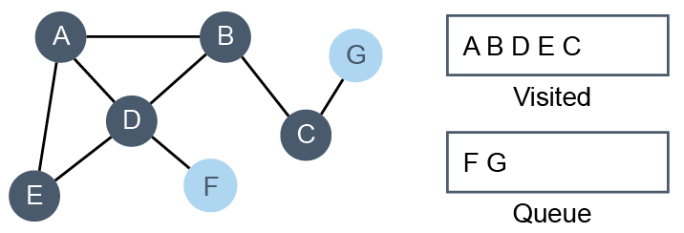
Breadth-first traversal
Add C’s adjacent node G to the queue
Colour G pale blue to show it has been queued

Slide 37
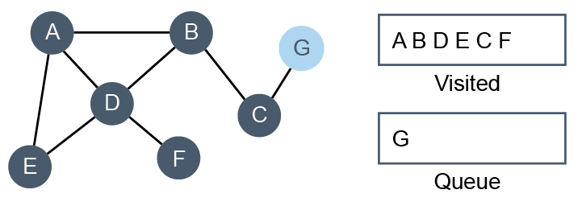
Breadth-first traversal
C’s neighbours are all coloured now, so dequeue F
Mark F by colouring it dark blue
Add it to the visited list

Slide 38
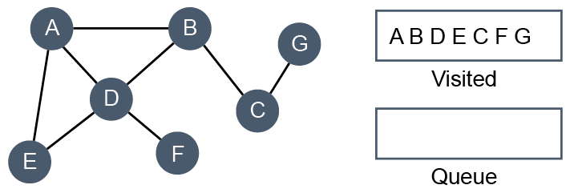
Breadth-first traversal
Finally, dequeue G, mark it by colouring it dark blue and add it to the visited list
The queue is now empty and all the nodes have been visited

Slide 39
Worksheet 2
Try Task 2 on the worksheet

Slide 40
Applications of breadth-first traversal
Finding the shortest path between two points
A Web crawler uses a breadth-first search to analyse sites that you can reach by following links randomly
Facebook uses a breadth-first search to find all the friends of a given individual

Slide 41
Complexity of DFS and BFS
A depth-first search and a breadth-first search both visit every vertex and explore every edge
In a sparse graph, the number of operations is therefore n + e where n = number of vertices and e= number of edges
This is effectively O(n)
In a graph which has the maximum possible edges, the adjacency matrix is full so there are n edges and n² edges, giving vn² + n
This is essentially O(n²) since only the dominant term is relevant

Slide 42
Plenary
There are two ways of searching a graph
Each has its own particular uses
Each uses a different supporting data structure in the traversal algorithm
What are the data structures used in each case?

